Slide 1



New Mexico Broadband Program
Basic Computer Skills
Module 1
Types of Personal Computers
Computer Hardware and Software

Slide 2
Basic Computer Skills
Learning Objectives
Acquire introductory familiarity with basic computer parts, terms, and functions
Notes:
In this module, you can expect to learn the following skills and tasks: First, you will develop a familiarity with basic computer terminology. This is important, since beginning skills require that you be able to understand and use the vocabulary associated with computers. Second, you will learn about the basic parts of computers and their functions. This will help you understand how the computer works and will help you understand future discussions about computer parts. Third, you will begin to acquire mousing and keyboarding skills. Using a mouse and a keyboard are important techniques for computer use – sort of like learning to use a hammer and saw if you want to become a carpenter. You will practice these skills and be provided with resources that allow you to continue that practice on your own.

Slide 3


First, let’s learn the basics about computers
For computers, as for anything else, different styles exist. The different styles reflect different functions.
Notes:
Let’s get started. We’ll begin by talking about the different kinds of home computers that are most common. This will help us get familiar with some key terminology, and will provide a solid context, or background, for some ideas that will be developed later.

Slide 4
Types of Computers
From largest to smallest, the main types of standard computers are:
  Desktop computer
  Laptop computer/notebook
  Tablet computers (iPad)
  Smartphones (iPhone, Blackberry)
Notes:
We will consider briefly four types of computers most common today. These are the desktop computer, the laptop computer, and what we once called personal digital assistants and are now generally referred to as smartphones, and the tablet computer, such as the iPad.

Slide 5
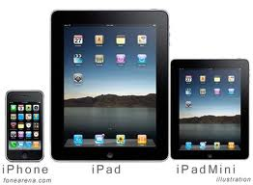
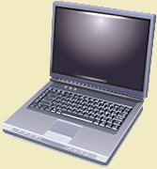
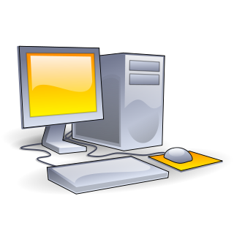
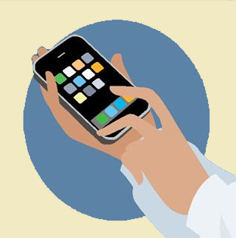
Types of Computers
Laptops
Desktops
Tablets
Smart phones
Notes:
Here you see the relative size of each of these computers. Because of their size, each of these computer styles is a better suited for different circumstances. Not only are smaller size machines lighter and more portable, but smaller size equipment also has smaller components and thus more limited capacity. In institutions such as offices, schools and libraries, where portability is not required, desktop models are most common. They also have the best capacities (we’ll discuss this more later). For individuals, especially those requiring or preferring some mobility of their machine, laptops are becoming increasingly popular. And for busy professionals who need to have their email, calendars, and files available for access while they are on the go, tablet computers and smartphones are almost a necessity.

Slide 6
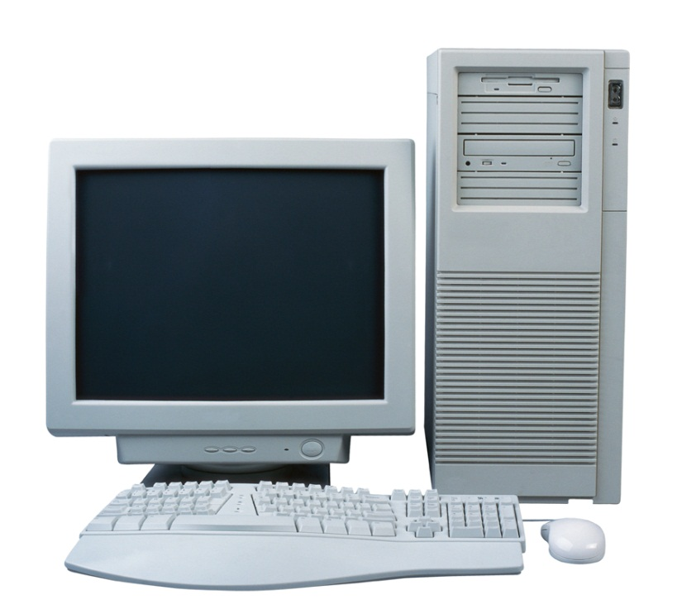
Desktop Components
  a case, or tower, that holds the computer’s “guts”
  a monitor, also called a screen
  a mouse, used to move and select information on monitor
  a keyboard, used to type in commands and documents
Notes:
Let’s take a moment to look at each of these four styles of computer a bit more closely and understand their capacities and limits.
Desktops are generally the most luxurious of the personal computer. They tend to have larger screens (you can purchase ones that are substantially larger) and a larger storage capacity than other models.
The case of the computer, that houses the processing unit, is call a tower if it is upright or the system unit.
The screen is referred to as a monitor. It is separate from the system unit.
The Keyboard is like a typewriter keyboard and is used to type commands and create documents.
The mouse is an external device used, together with the keyboard, to navigate the screen, select information, and initiate actions and commands.

Slide 7
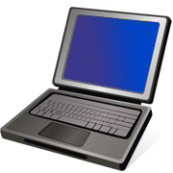
Laptop Computers
Designed to sit on your lap
Portable
Monitor & keyboard built in
Mouse built in as “touchpad”
Smaller models referred to as “notebooks” or “netbooks”
Notes:
The laptop is like a smaller, self-contained version of a desktop. All the features that we saw on the desktop – monitor, keyboard, mouse, system unit – are built into a single unit in a laptop. The screen and keyboard are often a bit smaller than those of a desktop and the mouse is a “touchpad” with two clicker keys.
There are smaller versions of this kind of computer called netbooks. Netbooks have limited storage and internet capacity, but are good for taking notes in class and checking email.
There are also newer versions of laptops called tablet style computers that have a keyboard built in as part of the screen, and are thus in the shape of a single tablet rather than that of a laptop in which keyboard and screen are hinged together. This type of screen, that contains a keyboard and other command keys, is called a touchscreen.

Slide 8
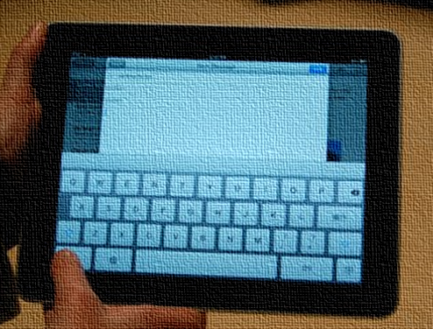
Tablet Computers
Lighter than laptops
Very portable
Keyboard built in on screen
Mouse built in on screen
Multiple uses
Merging functions
Notes:
The newest style of computer is the tablet style computer. These have a keyboard built in as part of the screen, and are thus in the shape of a single tablet rather than that of a laptop in which keyboard and screen are hinged together. You use the keyboard by touching the screen, hence the term “touchscreen”. Instead of a touchpad or mouse, you navigate the screen by using your hands on the screen to touch buttons and links, turn pages, and scroll down and across pages.
A tablet can be used as computer, book reader, gaming device, and music and video player. The increasing development of these machines and ever shrinking size of components has allowed tablet capacity to grow while still maintaining an elegant and sleek profile.

Slide 9
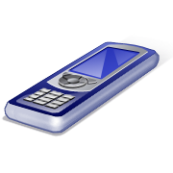
Smartphones
Hand-held devices
Function as “information managers”
Most connect to the Internet
Increased uses as computers
Notes:
Smartphone, such as the Blackberry, Droid, and iPhone, have increasing capacities as much more than phones, especially the “second generation” devices. These telephones that provide additional features such as calendars, music access, a variety of application tools called apps, and allow you Internet connectivity that enables you to receive email or search the web. In some cases, smartphones can be used as the key receiver for Internet signal and allow you to hook up a monitor and keyboard for increased functionality.

Slide 10
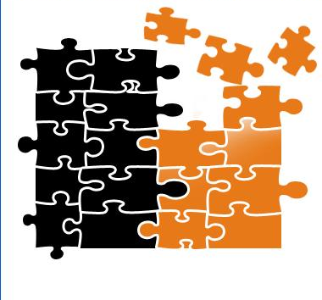
Now, let’s consider the basic components of a computer.
Notes:
Now that we’ve looked a bit at the most common types of personal computers, let’s consider the key components of the computer.

Slide 11
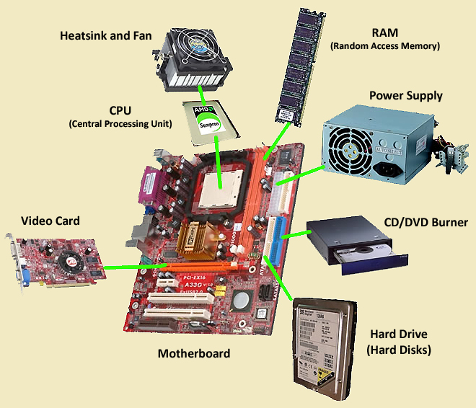
The physical parts of computers are called hardware and include elements both inside and outside of the computer.
Notes:
We are going to begin with what is referred to as computer hardware. Hardware simply refers to the parts that are actual physical parts. They could be large parts that we can see easily, such as the monitor or keyboard, or they could be smaller, internal parts, such as memory cards, the fan, or the processing chip. All of these are consider to be computer hardware.

Slide 12
Hardware
We are going to focus on internal hardware first.
Computer hardware generally consists of mostly metal parts with electronic circuitry and wiring.
The key elements of Hardware are:
  Central Processing Unit (CPU)
  Hard drive
  Random Access Memory (RAM)
  Ports and Peripherals
Notes:
Computer hardware generally consists of mostly metal parts with electronic circuitry and wiring.
The key elements of the Hardware are:
Central Processing Unit (CPU)
Hard drive
Random Access Memory (RAM)
Ports and Peripherals
Let’s look at each of these a bit more closely.

Slide 13
Central Processing Unit (CPU)
The central processing unit (CPU) is the “brains” of a computer. It is often called a microprocessor or microprocessing chip.
The CPU is a computation engine that:
    Allows the computer to perform operations
    Enables the computer to run software
    Determines how fast the computer can make calculations
Notes:
The first piece of computer hardware that we are going to consider is the central processing unit, or CPU.
The central processing unit (CPU) is the “brains” of a computer. It is often called a microprocessor or microprocessing chip.
We can think of the CPU as a computation engine. That is, it is the part of the computer that makes all the calculations that allow it to perform operations. It also allows the computer to run software applications. It is the primary factor in determining how fast the computer can process information and how rapidly it runs. When we talk about computer speed, we are generally referring to the speed of the microprecoessor.

Slide 14
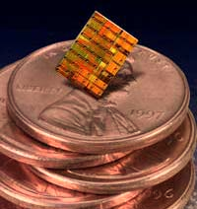
Despite this ability, the CPU is a very small.
Notes:
Despite this ability, the CPU is a very small.
You can see here that this CPU is much smaller than a penny.

Slide 15
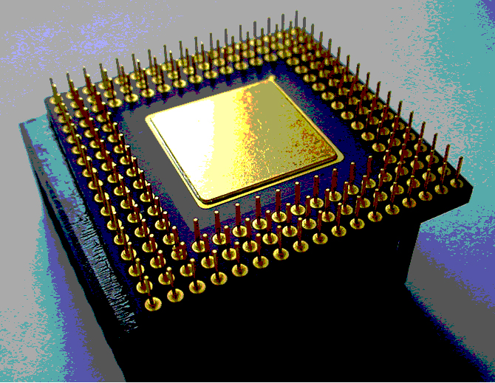
CPUs are made of thin silicon layers with electronic circuitry on and between layers.
New models of chips are multi-core and contain one or more processing chips within another, creating dual and quad-core processors.
Notes:
CPUs are made of thin silicon layers with electronic circuitry on and between layers. All the programming needed to process information and make calculations is contained in that miniscule area of circuitry.
New models of chips are multi-core and contain one or more processing chips within another, creating dual and quadruple core processors that can run even faster.

Slide 16
Hard Drive
The Hard drive is the physical location on which your computer’s information and data are stored. The hard drive:
Looks like an aluminum box
Contains electronic disks on which information is stored in electronic form
Can be read and written to with arms that function like a very precise record player arm
Notes:
The next key piece of computer hardware that we want to consider is the hard drive.
The Hard drive is the physical location on which your computer’s information and data are stored. The hard drive looks like an aluminum box with circuits on the outside. Inside, it contains electronic disks on which information is stored in electronic form. This information can be read from and written to with electronic arms that function like a very precise record player arms.

Slide 17
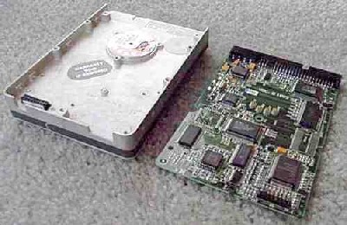
The hard drive contains wiring that allows it to be programmed and connects it to other parts of the computer.
Electronics and motor
Notes:
Here you can see the inside of the hard drive with the electronic circuitry on one side of the box.

Slide 18
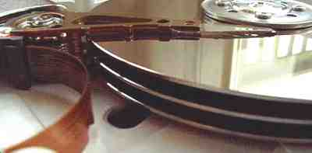
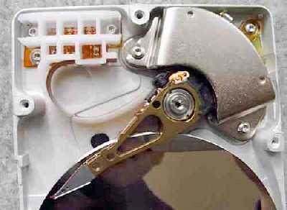
Three “hard disks” on the hard drive
The read/write arm
on the hard disks
Notes:
On the other side are the disks onto which information is stored and from which it is retrieved.
The read - write arm in the image on the right shows the mechanism by which information is transferred on and off the discs.
What this means is that each time to save information to your drive, directions are sent electronically to this arm that tell it to transfer that information onto one of the discs. That is, the arm “writes” the information onto the discs.
Similarly, when you retrieve information from your hard drive (such as a memo your wrote or a photo you took), directions are sent electronically to this arm that tell it precisely where to go in order to access that exact file. Like a an old-style record player that played music from vinyl records, the computer “reads” the information from the disc on the hard drive. Most often, we do not hear the information (unless we are listening to some music we saved), but instead we see it on our screen.

Slide 19
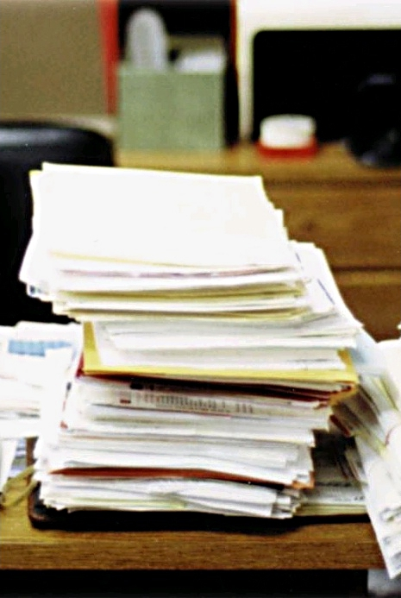
Computer Memory
A computer’s temporary memory is called RAM, short for “Random Access Memory”
Although called memory, RAM is best thought of as available work space.
The more RAM your computer has, the more “work,” or programs, you can open and work on simultaneously.
Computer RAM
Notes:
So far, we’ve mentioned both the CPU, or processor, and the hard drive, as key elements of hardware on the computer. The third item we are going to consider is what is referred to as the memory of the computer. Actually, there are several different kinds of so-called memory in a computer, but the most commonly mentioned one is known as RAM – random access memory – and that is the type of memory we want to discuss now.
RAM refers to what we call the computer’s “temporary” memory.
Unlike human memory, which we associate with the brain, RAM memory is similar to work area, rather like a desktop.
It affects how much information can be worked with at a given time. You can think of the measurement of RAM as a measurement of how much space you have on your desktop and how much you can bring out to work on at one time.
RAM also affects how quickly a computer will start up and how fast it will let you work, since the more programs you can open simultaneously, the more quickly your computer can execute tasks.

Slide 20

Computer Parts and their Function
RAM
The amount of RAM is an important factor in a computer’s performance.
The more RAM a computer has, the greater it’s ability to “multi-task.”
A large amount of RAM is like having a very large desk – it holds more!
Notes:
The amount of RAM is an important factor in a computer’s performance.
The more RAM a computer has, the greater it’s ability to “multi-task.”
If you think of RAM as desktop size, this makes sense - a large amount of RAM is like having a very large desk – it holds more!
RAM also affects how quickly a computer will start up and how fast it will let you work, since start up and work speed depend on the ability of the RAM to hold several programs open and running simultaneously.

Slide 21
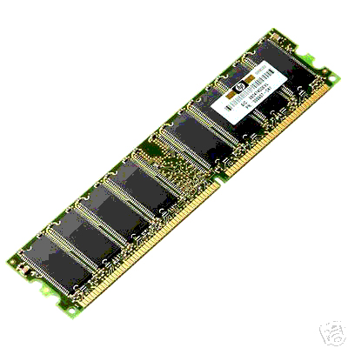
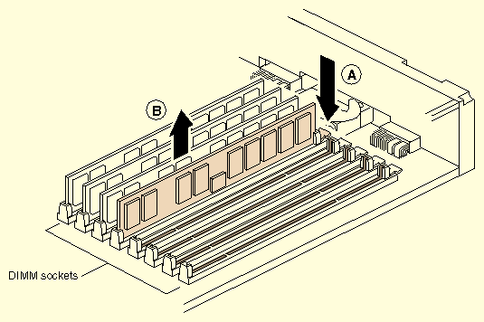
Computer Parts and their Function
Memory
Instead of being in your mind, the memory in your computer is held on DIMMs (dual in-line memory modules).
DIMMs are complex circuit boards that are installed inside your computer.
Notes:
Instead of being in your mind, the memory in your computer is held on DIMMs (dual in-line memory modules).
DIMMs are complex circuit boards that are installed inside your computer.
When you upgrade the memory in your computer, you are adding more DIMMS to the circuit board to increase your RAM.

Slide 22
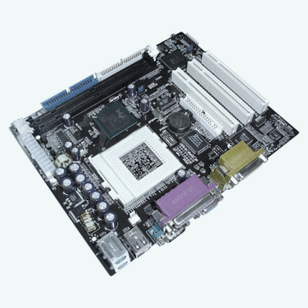
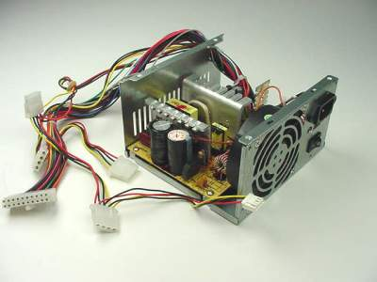
All these pieces get wired together on a motherboard, hooked up to a power supply and a fan,
Motherboard
Power supply
Notes:
All of the hardware we have been discussing - the CPU, the hard drive, and the RAM, are hooked up to a central circuit board, call the motherboard, connected to a power supply and a fan for cooling (because the small microprocessing chip generates a huge amount of heat) …

Slide 23
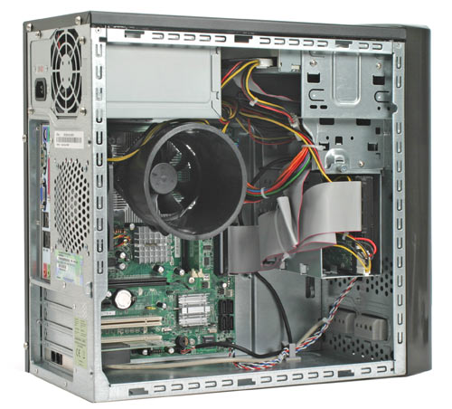
and put inside a computer case, where
he parts are held in place
Notes:
and held together in place inside the case or tower…

Slide 24
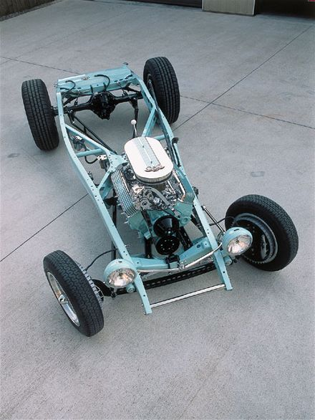
much like a car chassis holds the parts of a car in place.
Notes:
much like the parts of a car are hooked up to a motor and held together by a chassis.

Slide 25
Now let’s look at the final hardware component of a computer, the peripherals and ports.
Peripherals are the external hardware devices that get plugged into your computer.
They can include anything from keyboards to cameras.
Laptops have fewer peripherals in their standard set up.
Notes:
That’s some of the hardware associated with the “guts” of the computer. But there are other hardware elements that are external to the actual case that are also important.
Any piece of hardware that is external to the central case is called a peripheral. These can include anything from keyboards to cameras.
Peripherals are generally plugged into the computer, and some are also plugged into an external source for additional power. More and more peripherals are now “wireless” and can align with a computer without any physical wired connection.
Laptops generally have fewer peripherals in their standard set up, though they can accommodate most peripherals as well as a desktop. You can add an extra screen or keyboard to a laptop as a peripheral if you connect them.

Slide 26
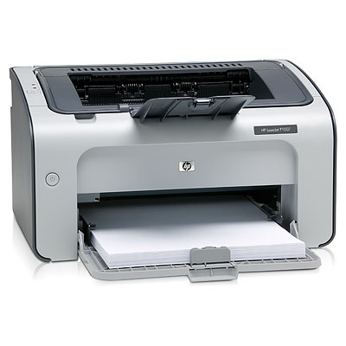
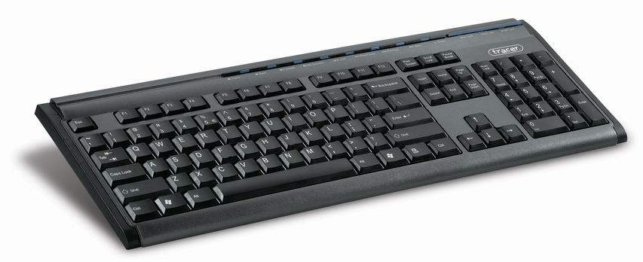
Some examples of peripherals are printers and keyboards.
Notes:
Peripherals are generally plugged into the computer, and some are also plugged into an external source for additional power. More and more peripherals are now “wireless” and can align with a computer without any physical wired connection.
Laptops generally have fewer peripherals in their standard set up, though they can accommodate most peripherals as well as a desktop. You can add an extra screen or keyboard to a laptop as a peripheral if you connect them.

Slide 27
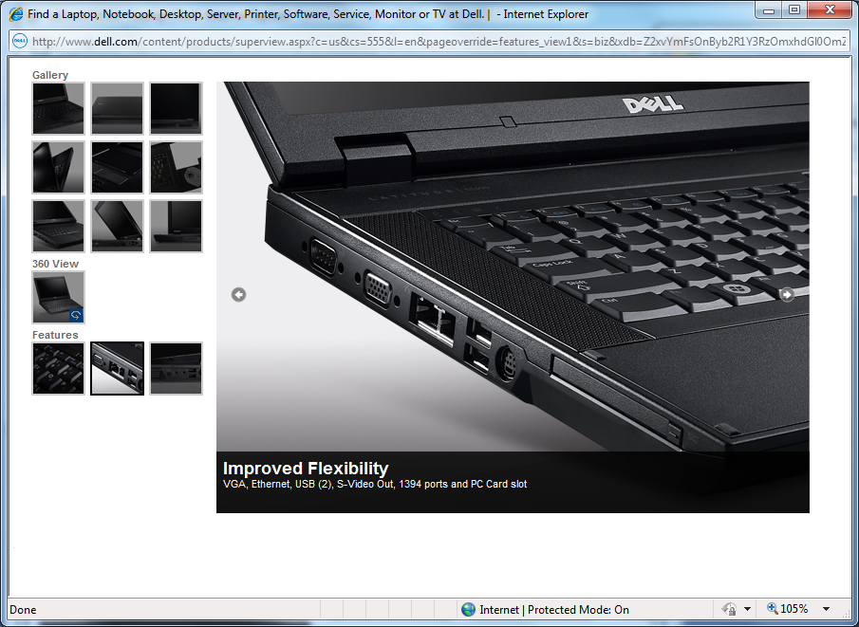
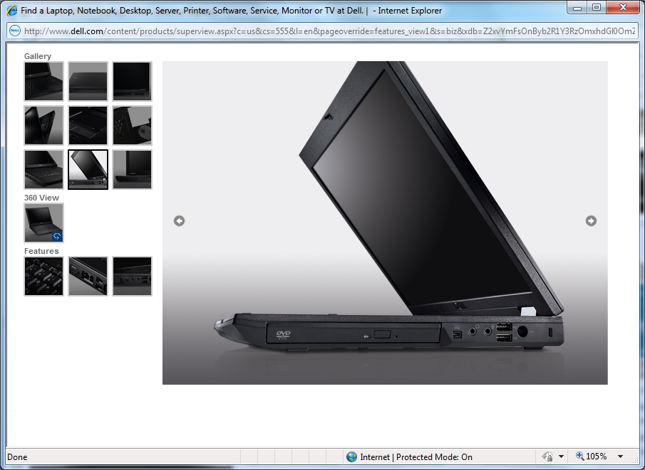
Ports on Your Laptop
Ports are docks, or connecting plugs, for your peripherals.
They are the locations on your computer at which you connect peripherals.
Each peripheral is designed to connect to a particular kind of port.
The left side of a laptop
The right side of a laptop
Notes:
On the laptop, you will see ports on both the right and left side of the computer.

Slide 28
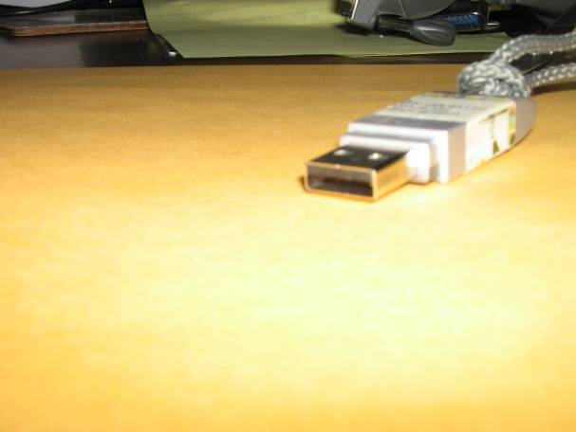
Ports for peripherals on a Laptop
 | USB Plug | The most common ports and plugs are USB. USB stands for “Universal Serial Bus.” These plugs and ports are used for many peripherals, such as digital cameras, modems, scanners, webcams, and even your mouse.
*
Notes:
The most common type of plug and port, which are now being used for more and more devices, is the USB connection (Universal Serial Bus). The term “BUS” stands for binary unit system, the system of measurement used for computer information. Many laptops have several USB ports, and they can be used interchangeably for any USB plug.
Many desktops now have one or more USB ports on the front of the case to make it easier to plug in external devices.
Most of the common peripherals, with the exception of printers, use USB plugs. If you look at the plug on the end of your mouse, you will see it is a USB plug.
USB ports are interchangeable. That is, if you have a USB plug on a peripheral device, you may plug it into any of the USB ports on your computer.

Slide 29
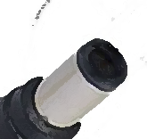
Ports for power
 | A/C (Power) Plug | Most computers have round ports for the AC power plug. On a laptop, these ports are on the back or the right side.
*
Notes:
Another important style of port and plug to be aware of is the power plug. On most laptops, this is a small, round metal plug with a single prong in the center. It plugs into a port of corresponding shape.

Slide 30
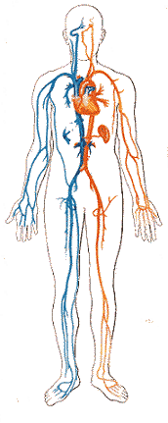
Now that we’ve looked at the basic parts of the computer, let’s look at the systems that keep it running.
Notes:
Now that we’ve discussed some of the key hardware parts of the computer, we are going to look at the systems that allow the computers to run and perform specific tasks.

Slide 31
Software
Software is the entire set of programs and procedures associated with a computer. You can think of software as “instructions” rather than the “physical parts” of hardware.
Software comes in two forms:
  Operating system software
  Applications software
Notes:
These systems are known together as “software.” In contrast to hardware, they are not physical elements, but rather the entire set of programs associated with a computer.
You might think of software as sets of directions, that tell the hardware how to operate and what to do.
We distinguish between two kinds of software:
Operating system software and application software.

Slide 32
Operating System (OS) Software
Operating System, or “OS,” software, is what lets the computer run by setting up the overall requirements in which tasks can be performed.
You can think of an OS as similar to electricity in a house kitchen – it is the general background system that allows you to run your appliances.
Notes:
Operating System, or “OS,” software, is what lets the computer run by setting up the work space environment in which tasks are performed.
You can think of an OS as similar to electricity in a house or blood in a body – both are larger systems needed to undertake any operation.
Application Software allows you to do different kinds of work in your workspace.
Application software can be compared to a blender in your kitchen or your eye – both designed to perform specific tasks, rather than for keeping the entire system running.

Slide 33
Application Software, or Programs
Application Software allows you to do different kinds of work.
Application software can be compared to an appliance in your kitchen, such as a blender, which is designed to perform specific tasks. Like appliances, each software application allows you to perform different tasks.
Notes:
Operating System, or “OS,” software, is what lets the computer run by setting up the work space environment in which tasks are performed.
You can think of an OS as similar to electricity in a house or blood in a body – both are larger systems needed to undertake any operation.
Application Software allows you to do different kinds of work in your workspace.
Application software can be compared to a blender in your kitchen or your eye – both designed to perform specific tasks, rather than for keeping the entire system running.

Slide 34
Application software
Performs specific tasks
Operating System
Runs the system
Notes:
Operating System, or “OS,” software, is what lets the computer run by setting up the work space environment in which tasks are performed.
You can think of an OS as similar to electricity in a house or blood in a body – both are larger systems needed to undertake any operation.
Application Software allows you to do different kinds of work in your workspace.
Application software can be compared to a blender in your kitchen or your eye – both designed to perform specific tasks, rather than for keeping the entire system running.

Slide 35
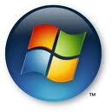
Operating Systems vary, but they all do the same thing – they allow the computer to run.
The OS for most non-Mac is Microsoft Windows. The most recent version of Windows is Windows 7.
Other Operating Systems
Mac OS for Apple
Unix
  Linux
Microsoft Windows logo.
Notes:
Operating Systems vary, but they all do the same thing – allow the computer to run.
The OS for most non-Macintosh computers is Microsoft Windows. Recent versions of Windows include Vista, XP, and the newest, Windows 7.
Most new computers come with an operating system already installed, so you do not have to worry about loading it on a computer.

Slide 36
Application Software
Designed to help users perform particular tasks, such as word processing, spreadsheets, or creative computer painting.
Word, Excel, PowerPoint, and Paint are all examples of application software.
Application software is sometimes referred to as software applications, applications, or programs.
Notes:
Application software is Designed to help users perform particular tasks, such as word processing, spreadsheets, or creative computer painting.
Word, Excel, PowerPoint, and Paint are all examples of application software.
Application software is sometimes referred to as software applications, applications, or programs.
Application software must either be purchased (as Microsoft Office Suite, which includes several software programs) or downloaded from the Internet (usually for free) and installed.

Slide 37
Review software
Operating System Software
Similar to:
Electricity in a house
Produces:
System requirements
Interface between user and computer
Application Software
Similar to:
Appliances
Produces:
Specific tasks
Specific products
Notes:
So – to recap the difference between operating system software and application software:
Both are sets of instructions in the computer that allow it to operate
OS software is broader and more general in scope – it creates the overall work environment on the computer and the interface between the computer and the user.
Examples of OS software is Microsoft Windows.
Application software if more specific in scope – each application creates the ability to perform specific tasks and create specific products.
Example of application software is Word or Excel.

Slide 38
Review of Hardware
Hardware
Software
Central Processing Unit (CPU)
Hard drive
Random Access Memory (RAM)
Ports and Peripherals
Operating System
(OS)
Application Software
Notes:
And – to recap the more general differences between the elements of the computer that we have reviewed in this module –
Hardware constitutes the physical components of a computer.
Significant internal hardware include the CPU, the hard drive, and RAM.
External hardware, called peripherals, are also common in computer use.
Software constitutes the set of instruction on a computer.
There are two kinds of software – operating system software and application software.
OS software creates the general interface environment.
Application software creates the tools for specific tasks, or applications.

Slide 39
We appreciate the time you spent with us.
We hope to see you at the next training!
These materials were created collaboratively by the
New Mexico Department of Information Technology, Fast Forward New Mexico,
and the New Mexico State Library, under grants provided by the
National Telecommunications and Information Administration.
These materials are not to be used for profit.
Connecting you to a world of opportunities

